Slide 1


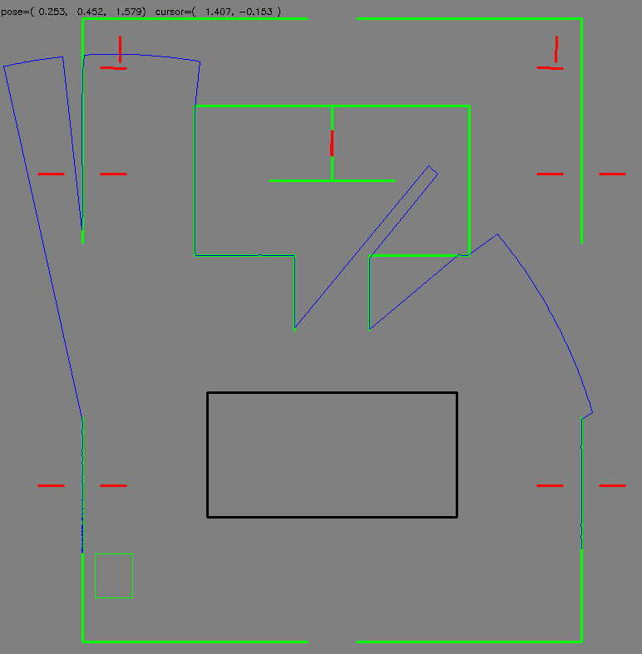
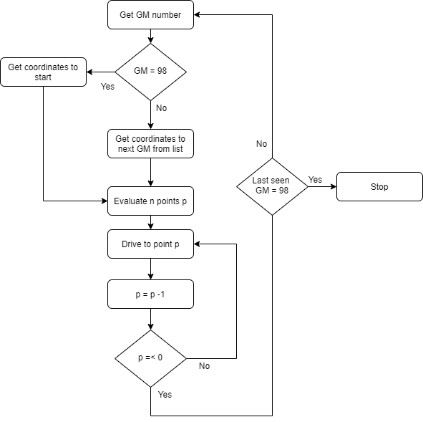
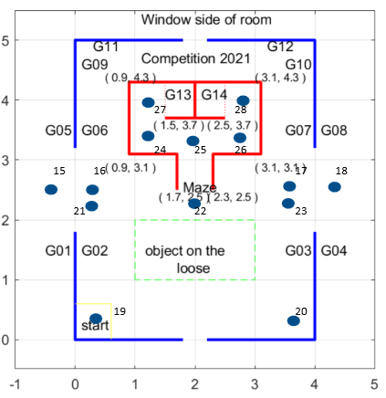

Team 20
Emil Brændstrup Madsen s155906, Gustav Ohlendorff Brønd s173900, Alexander Mizrahi-Werner s173403, Lasse Lykke Nielsen s161756.
The Task
The robot must navigate in a track with some guidemarks (see [2]) and a maze. The robot must go to a predefined guidemark, here it must read the number for the next guidemark, go there and so on. When it reaches a guidemark with number 98, it must go to the to the black square and detect an object. It can be 4 different kinds of objects, 2 different squares or 2 different triangles. In addition to detecting which kind of object it is, it also must detect the orientation of the object.
Track for the SMR [2]
Flowchart for going through guidemarks [3]
Going through the track
Identify figure
Track with added nodes [1]

